Slide 1
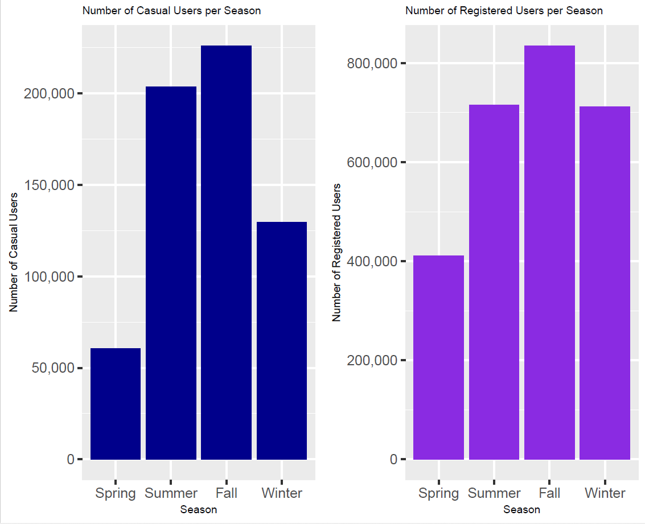
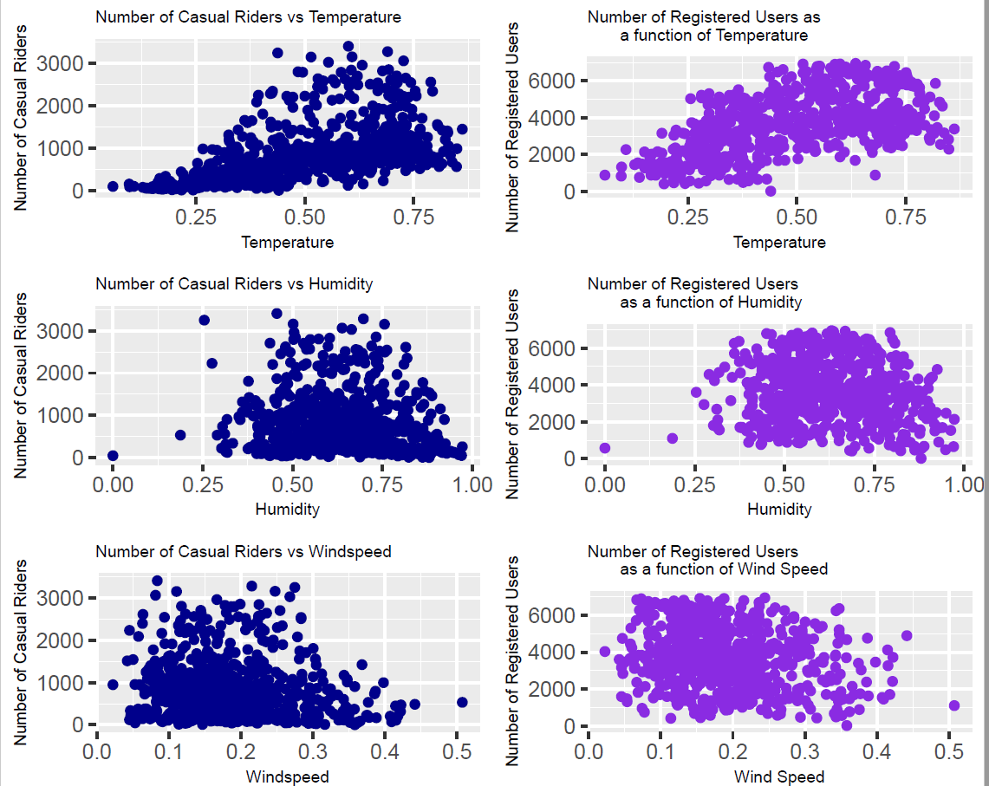
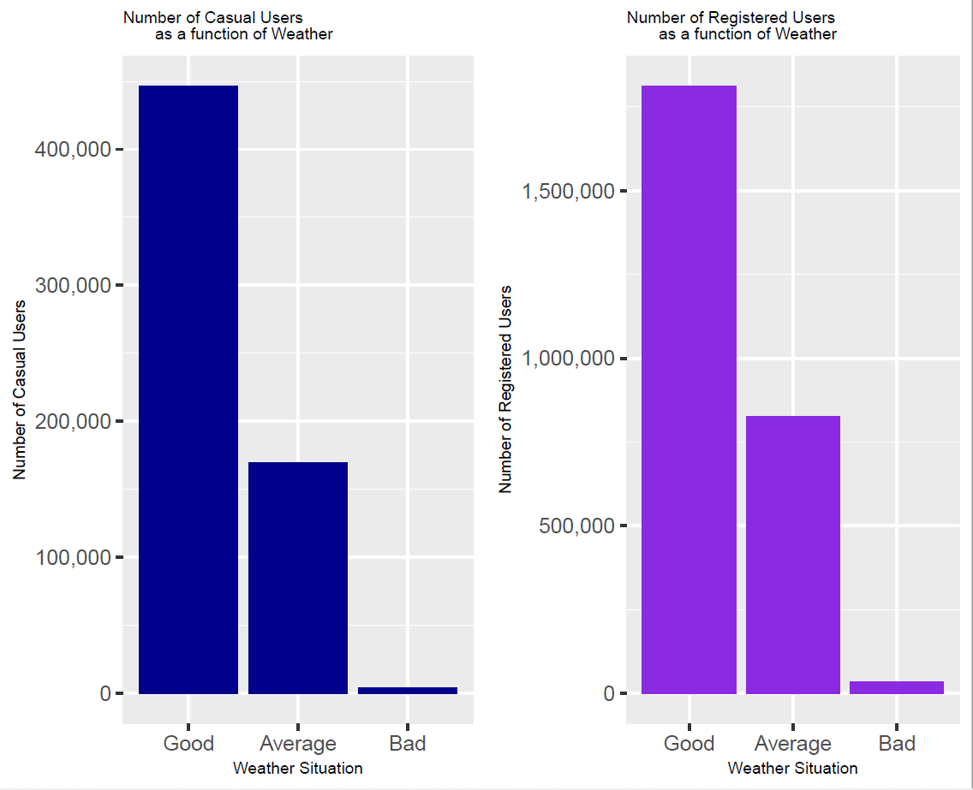
Environmental factors have a similar effect on Bicycle Demand from Casual & Registered users alike.
Method: Studying demand on bicycles from Casual vs Registered users throughout the year and with varying environmental conditions.
Findings: The overall demand on bicycles drops during Seasons 1 and 4 (Spring and Winter). The demand also drops at the extreme values of temperature, humidity and wind speed.

